Slide 1
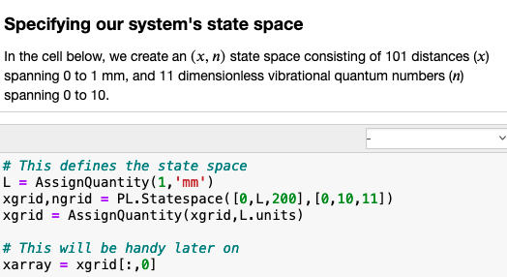




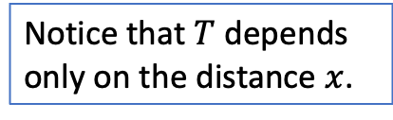
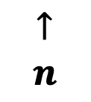

We construct a “state space” in which one dimension is $x$, and the other is quantum number $n$
$$10$$
$$↑$$
$$n$$
Notice that $T$ depends only on the distance $x$.
$$0$$
$$0$$
$$x→$$
$$L$$

Slide 2

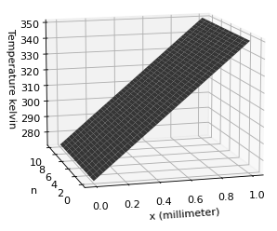
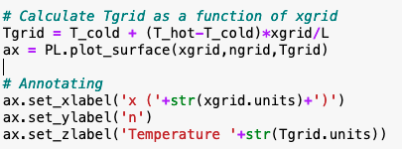
Visualizing temperature in that state space

Slide 3
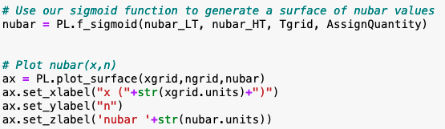
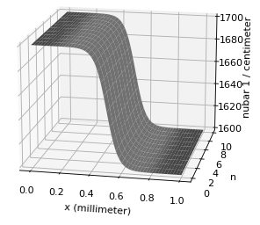

Visualizing $\overline{ν}$ (from Spartan) in that state space
$\overline{ν}$

Slide 4

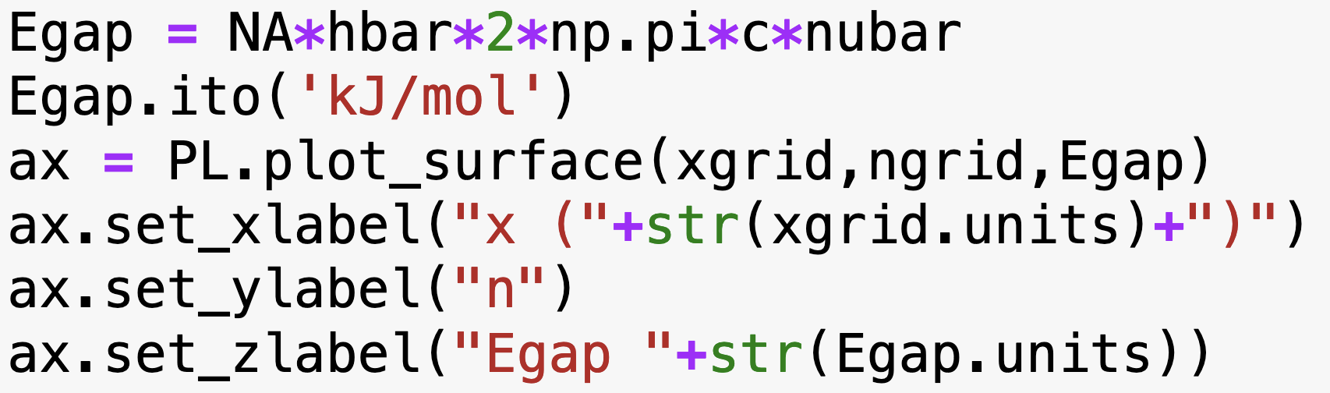
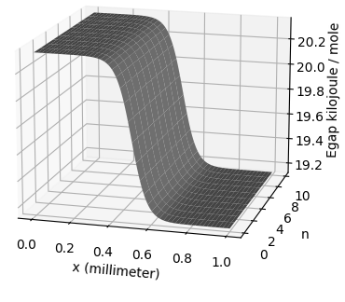

From $\overline{ν}$ $→E_{gap}$
$$E_{gap}$$

Slide 5

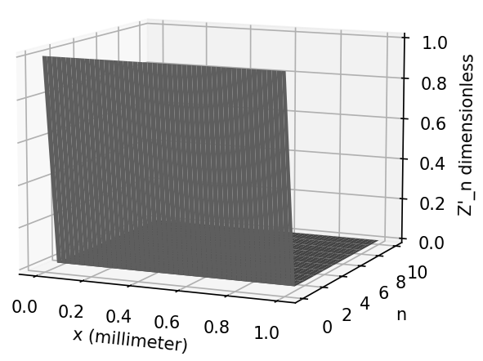

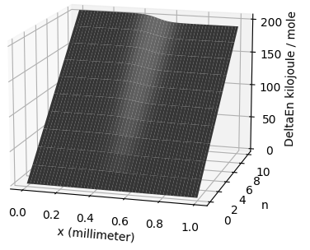

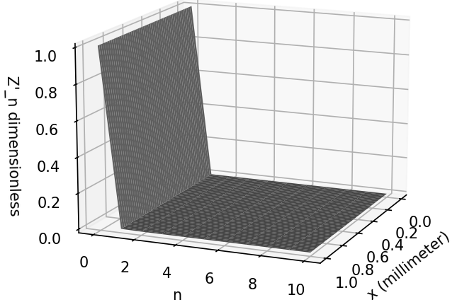



From $E_{gap}$ $→$ ${∆E}_{n}$ $→$ $Z_{n}′$
$Z_{n}′$
${∆E}_{n}$
$Z_{n}′$

Slide 6
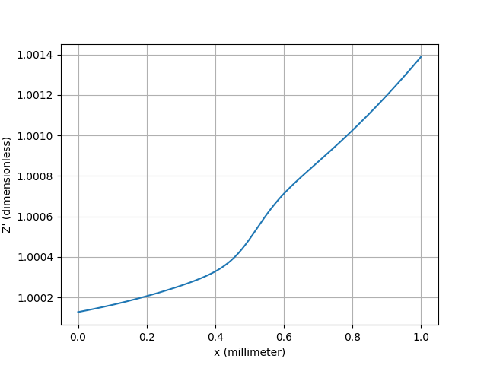


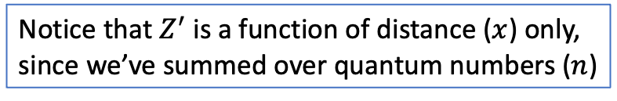

From $Z_{n}′$ $→ Z^{′}$
$Z_{n}′$
$Z^{′}$
Notice that $Z^{′}$is a function of distance ($x$) only, since we’ve summed over quantum numbers ($n$)

Slide 7

From $Z^{′}$ $→$ $Z$

Slide 8
From $Z^{′}$ $→$ $Z$

Slide 9

From $Z$ $→$ $∆U_{sol}$

Slide 10
From $Z$ $→$ $∆U_{sol}$

Slide 11
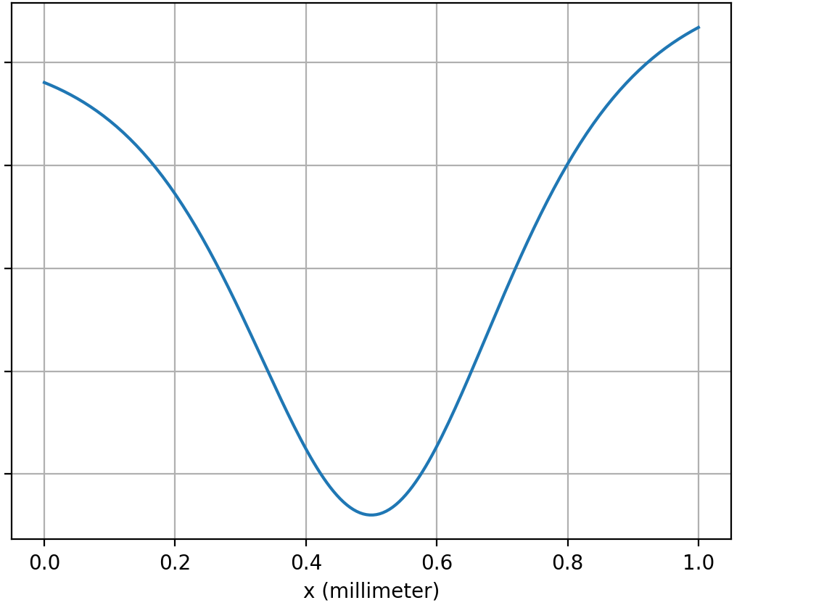


From $Z$ $→$ $∆U_{sol}$
$$∆U_{sol}$$

